Slide 1
ML Car Price Prediction
Members:
RAYA HARISH (WX2EE50531)
ANANNYA SINGH (3NJZ6RGL7W)
PAVAN JACOB ABRAHAM (0VJK2O7W3P)
ANMOL GUPTA (6Q2YCTLSMW)
PRESENTED BY: GROUP 2

Slide 2
Problem Statement
Develop a model to predict car prices based on independent variables, helping management make informed decisions on car design, business strategy, and market pricing dynamics.

Slide 3
1.Car_ID - Unique ID for each observation.
2. Symboling - Its assigned insurance risk rating, value +3 indicates that the auto is risky, 3. that it is pretty safe.
3. carCompany - Name of company, 4. fueltype - Car fuel type.
5. aspiration - Aspiration used in car, 6. doornumber - Number of doors in a car
7. carbody - body of car, 8. drivewheel - type of drive wheel
9. enginelocation - location of car engine, 10. wheelbase - Wheelbase of car
11. carlength - length of car, 12. carwidth - width of car
13. carheight - height of car
14. curbweight - The weight of a car without occupants or luggage.
15. enginetype - type of engine, 16. cylindernumber - cylinder placed in the car.
17. enginesize - size of car, 18. fuelsystem - Fuel system of car.
19. boreratio - Boreratio of car, 20. stroke - Stroke or volume inside the engine.
21. compressionratio - compression ratio of car, 22. horsepower - Horsepower
23. peakrpm - car peak rpm, 24. citympg - Mileage in city
25. highwaympg - Mileage on highway, 26. Price( Dependent Variable) - Price of car
Data Description

Slide 4

Data Cleaning
and
Problem Solving Steps

Slide 5
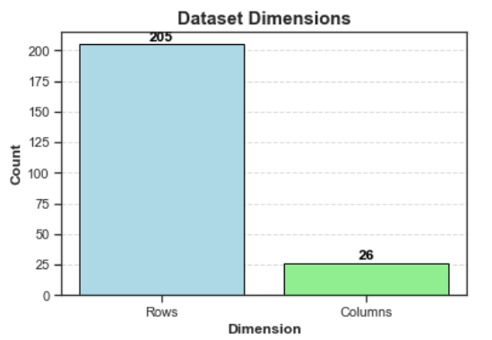
Import Required Libraries, Read Dataset and Check Dimensions
Imported libraries
Rows: 205 rows
Columns: 26 columns

Slide 6
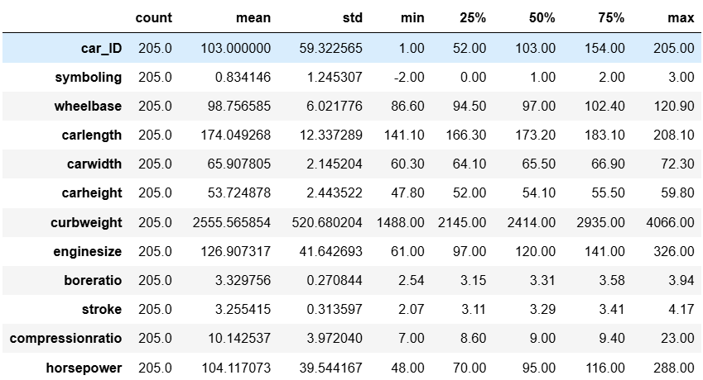
Data Types and Data Description
1.No Null Values in dataset and Data Types are Appropriate
2.Prioritize safety features, offer diverse vehicle sizes, emphasize stable engine designs, and target segments with tailored strategies matching financial profiles. Promote fuel efficiency for eco-conscious buyers and showcase performance for enthusiasts.

Slide 7
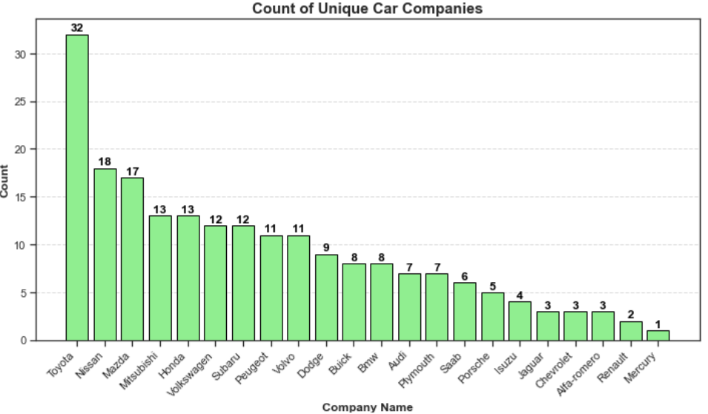
Create the column as CompanyName using CarName Column. List down the unique CompanyName Check the correctness of data in the CompanyName column, Check the duplicate data in the da
1. No duplicate entries exist in the dataset.
2. Among the 22 car companies, Toyota is the most purchased, while Mercury is the least purchased.

Slide 8
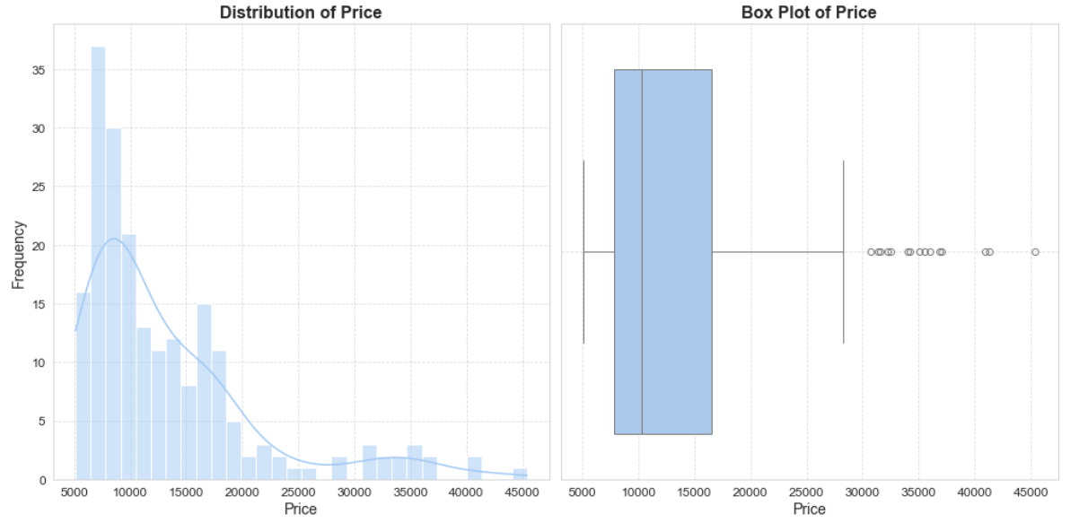
Visualize the price column using displot and boxplot. Write down the observations
Displot and boxplot reveal price fluctuations with a potential upward trend.

Slide 9
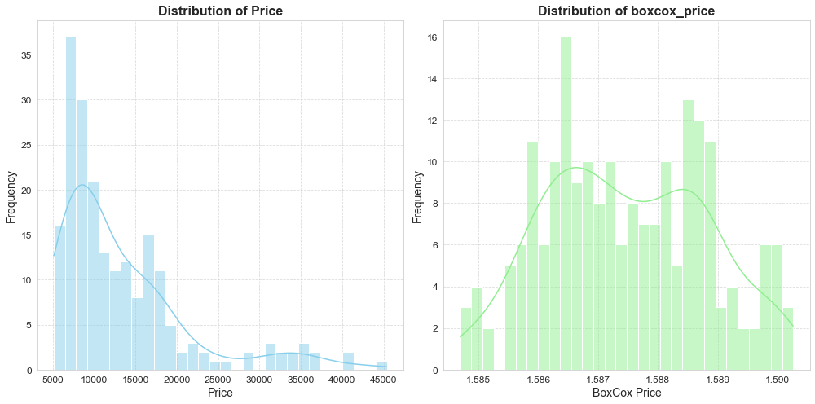
Perform the appropriate transformation to make the target as a gaussian distribution

Slide 10
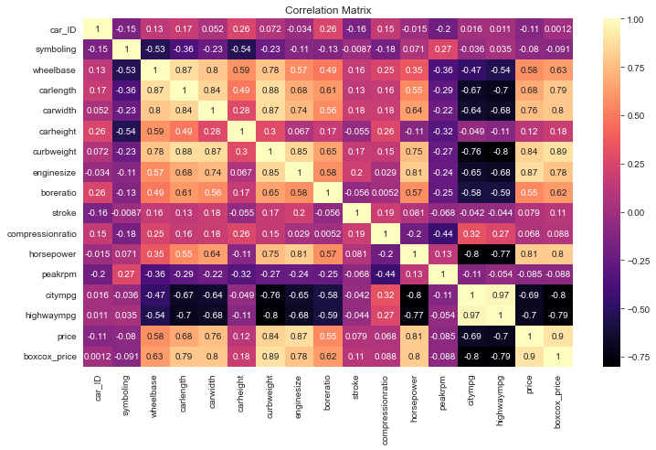
Check the linear relationship between the dependent variable "Price" and the numerical independent variables
1.Higher car prices correlate positively with horsepower, engine size, curb weight, and wheelbase
2.Negatively correlating with city and highway MPG; car width correlates with car length, and bore ratio with stroke length.

Slide 11
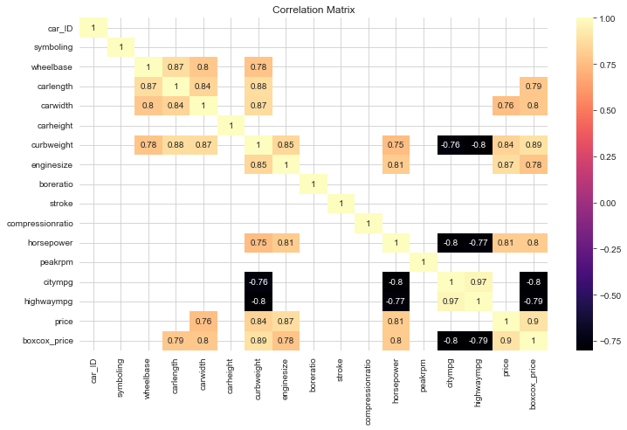
Checking the multicollinearity between the correlated independent variables above and Price
CarWidth, Carlength, Curb Weight and Engine Size has strong multicollinearity with Box_Cox_Price

Slide 12
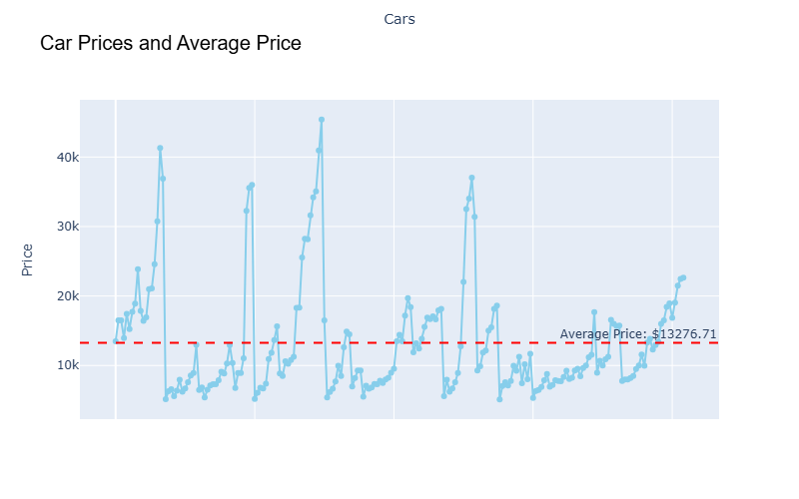
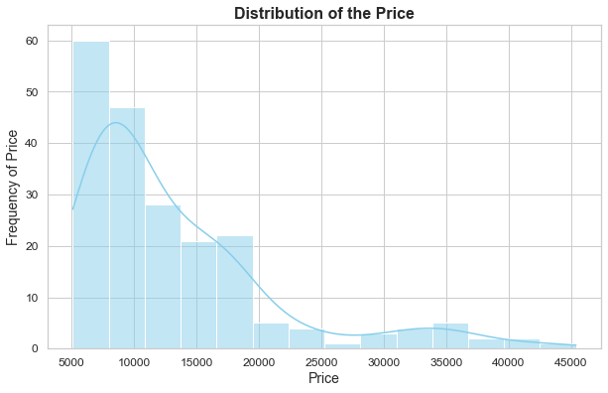
What is the distribution of car prices? Are there any outliers in car prices? What is the average price of cars?
Distribution is Right Skewed and There are few outliers in Price column.
The average price of cars is: $13276.71

Slide 13
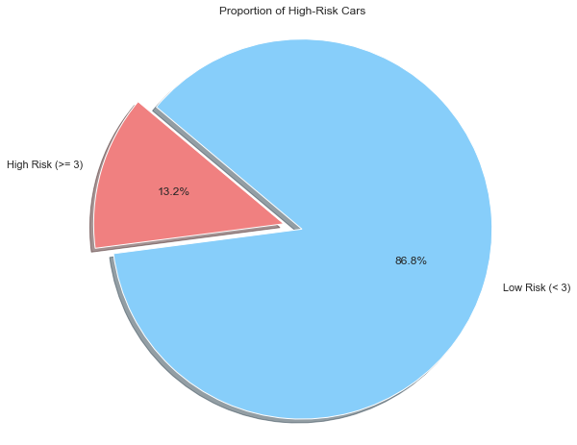
What proportion of cars fall into the high-risk category?
Proportion of cars in the high-risk category (symboling >= 3): 13.2%

Slide 14
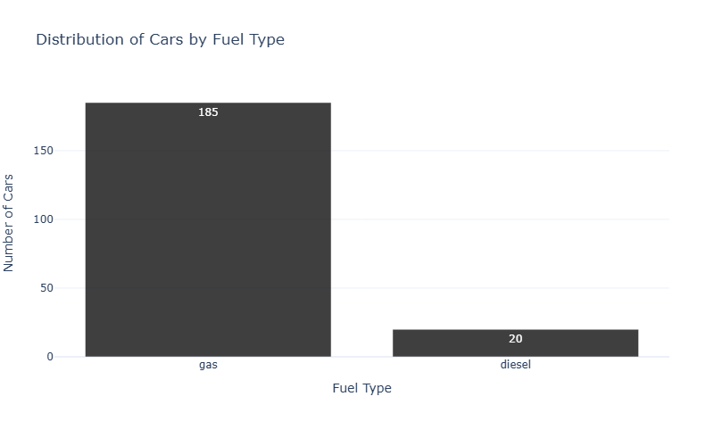
What is the distribution of cars by fuel type? Which fuel type is more common among the cars?
The most common fuel type among the cars is: gas with 185

Slide 15
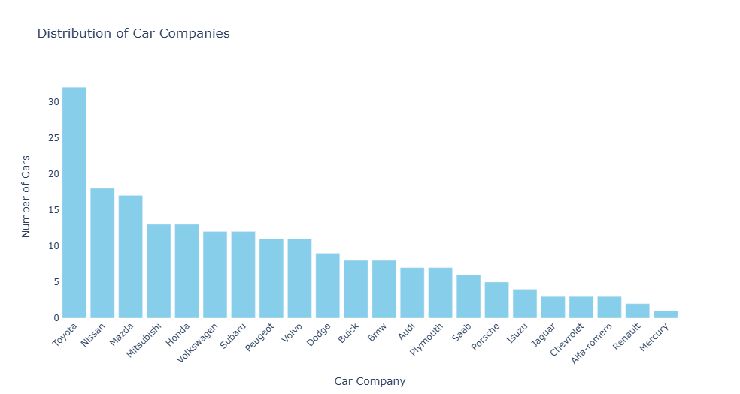
What is the distribution of car companies in the dataset? Which car company has the highest representation?
The car company with the highest representation is Toyota with 32 cars.

Slide 16
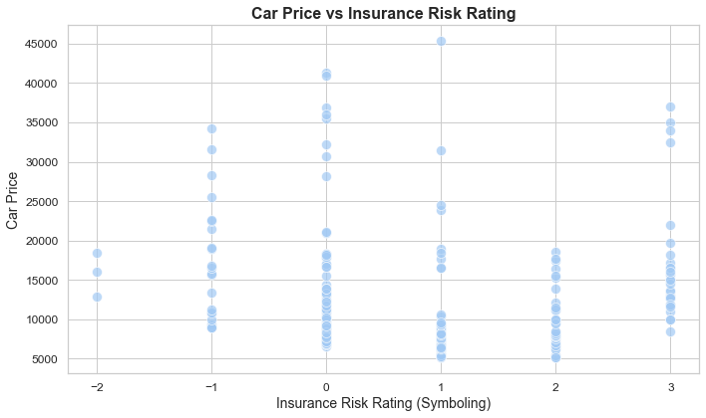
How does car price vary with the insurance risk rating?
The scatter plot shows no clear relationship between car prices and insurance risk ratings (symboling), with car prices spread across all risk ratings without a distinct pattern.

Slide 17
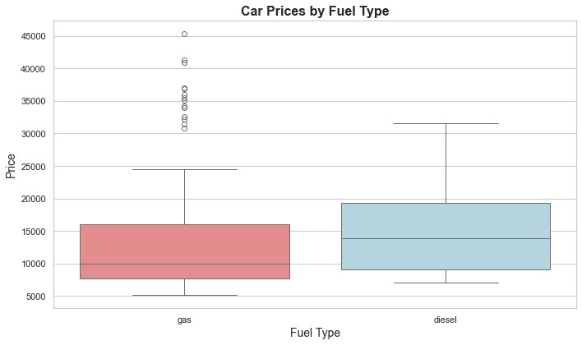
How do car prices differ between petrol and diesel cars?
Diesel cars tend to have higher prices with less variability compared to gas cars, which show a wider price range and more outliers.

Slide 18
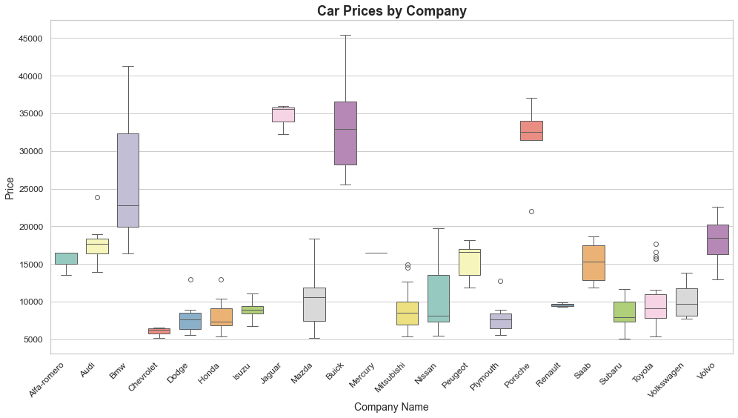
Are there significant differences in car prices among different car companies?
The image depicts car prices with significant variation across manufacturers, including outliers at both extremes.

Slide 19
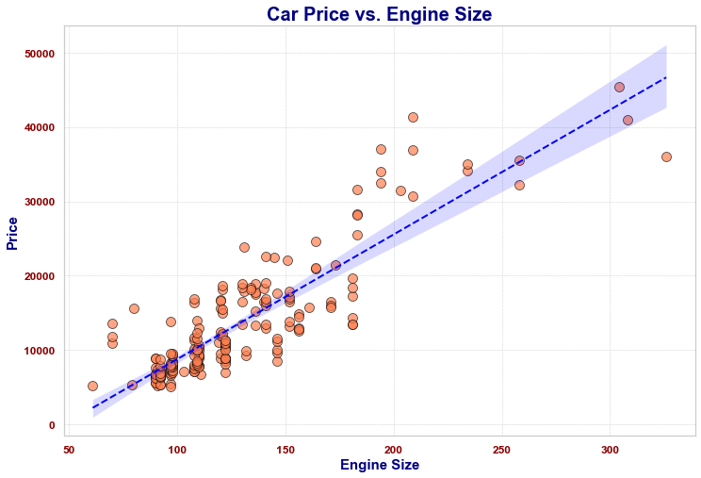
What is the relationship between engine size and car price? Does a larger engine size correspond to a higher price?
cars with larger engines are priced higher compared to those with smaller engines

Slide 20
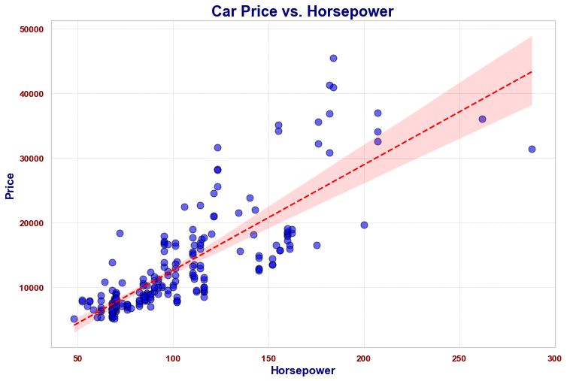
How does horsepower affect car price? Is there a linear relationship between horsepower and price?
There is a positive linear relationship between horsepower and car price, but it is not perfectly linear due to the variability in the data

Slide 21
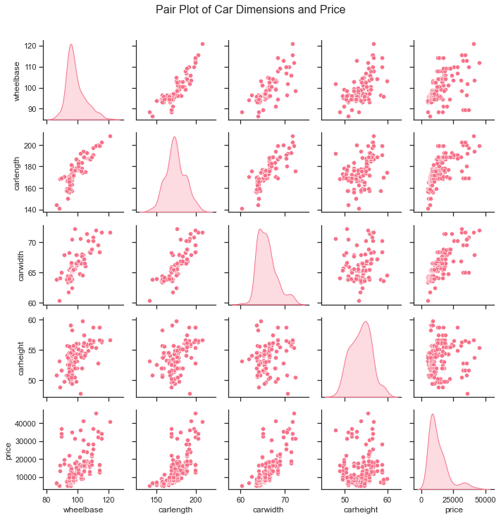
How do dimensions like wheelbase, car length, car width, and car height collectively influence the price?
There is a positive correlation between car price and car dimensions (wheelbase, car length, car width, and car height)

Slide 22
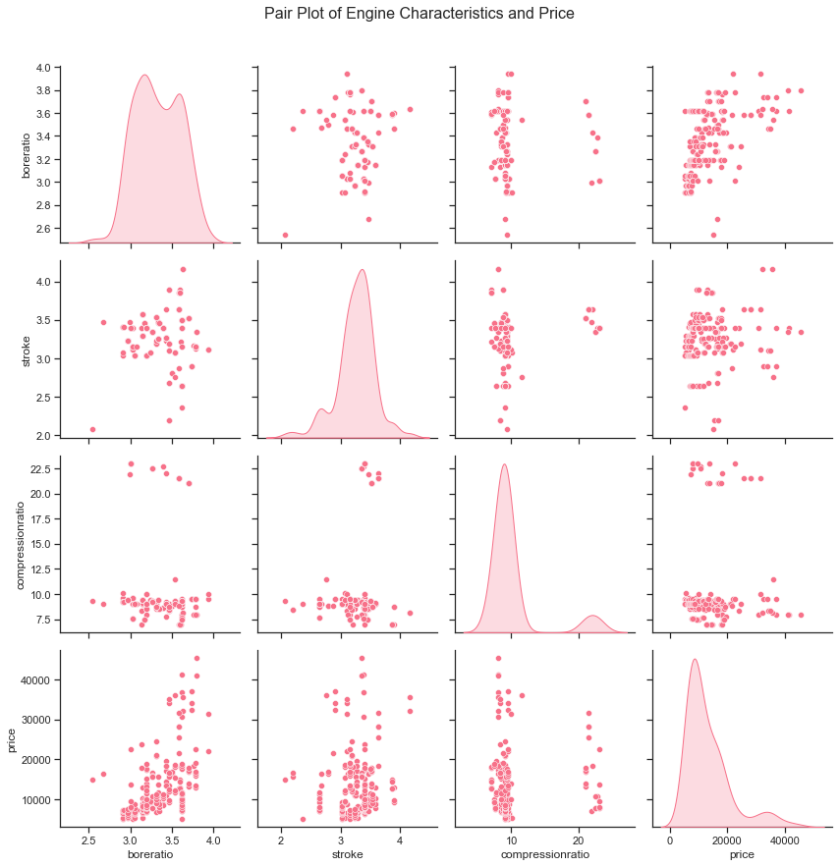
How do engine characteristics such as enginetype, cylindernumber, boreratio, stroke, and compression ratio affect car price when considered together?
there is a positive correlation between some engine characteristics and price

Slide 23
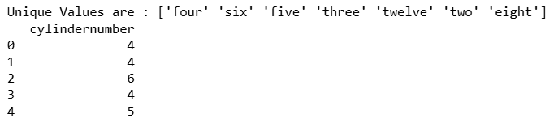
How can I map the categorical values of the 'cylindernumber' feature to numerical values in my dataframe? How can I create new features like 'carvolume', 'powertoweightratio', 'totalenginevolume', and then drop the original columns from the dataframe?
1.we can combine length, width and height to make it volume
2.Horse power and curbweight made be made for Power-to-weight ratio.
3.We can have total volume of all cylinders in engine: Number of Cylinders×π×(Bore/2)sq ×Stroke
4.bore=bore ratio*stroke

Slide 24
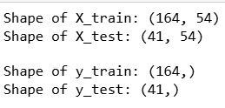
How can I split my data into training and testing sets while combining numerical and categorical features, and then print their shapes?
the shape of the train and test data

Slide 25
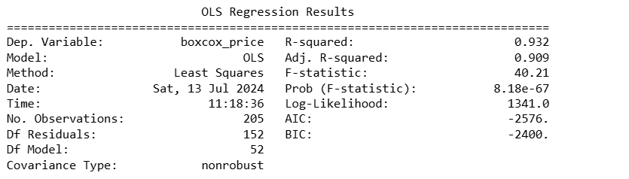
Build a Base Model with OLS
R2: 93% and Adjusted R2: 90%
These are the columns with P_Value <0.05 are enginesize, citympg, highwaympg, fueltype_gas, aspiration_turbo, carbody_hardtop, carbody_hatchback, carbody_sedan, carbody_wagon, fuelsystem_idi, fuelsystem_mfi, fuelsystem_mpfi, fuelsystem_spdi

Slide 26
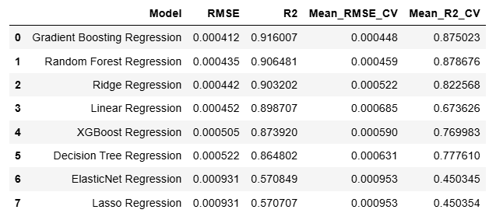
Which regression model has the lowest RMSE on the test set according to the provided code? Model building without Hyper Parameter Tuning
Gradient Boosting Regressor performs best with the lowest RMSE and highest R2, while ElasticNet and Lasso Regressor perform worst with the highest RMSE and lowest R2.

Slide 27
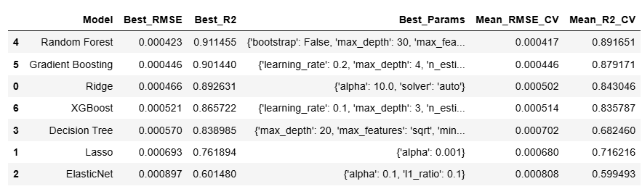
Which regression model achieved the lowest RMSE after hyperparameter tuning ?
Random Forest Regressor performs best with the lowest RMSE and highest R2, while ElasticNet and Lasso Regression perform worst with the highest RMSE and lowest R2.

Slide 28
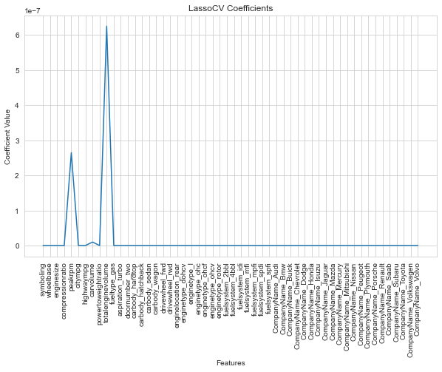
Feature Selection with LassoCV
Selected Features after LassoCV are 1.peakrpm
2.carvolume
3.totalenginevolume

Slide 29
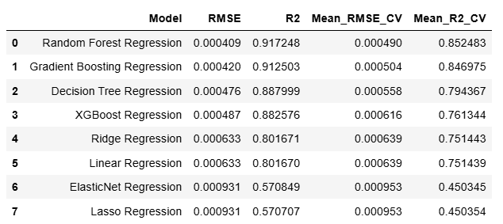
Model Building With Selected Features and Without Hyper Parameter Tuning
Random Forest Regressor performs best with the lowest RMSE and highest R2

Slide 30
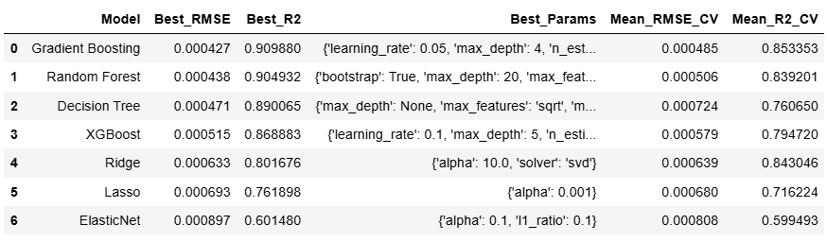
Model Building With Selected Features and Without Hyper Parameter Tuning
The best Model is Gradient Boosting Regressor with selected features (peakrpm, carvolume, totalenginevolume, enginesize, citympg) Low RMSE and High Accuracy

Slide 31

What could have been done better
1. Feature Engineering:
- Explore and create additional relevant features.
2. Hyperparameter Tuning:
- Expand hyperparameter search using techniques like Bayesian Optimization or Random Search.
3. Model Ensemble:
- Implement blending or stacking of multiple models.
4. Data Preprocessing:
- Detect and handle outliers to improve model stability.

Slide 32
Takeaway Points
Out of all columns there are few columns which is really affecting the over all performance of a model they are car volume (car length, car width, car height), total engine volume (cylinder number, stroke, bore), peak rpm, engine size, mpg.
feature engineering helped to overcome the multicollinearity problem.
LassoCV helped to find the best feature which truely impacts the model performance

Slide 33
Conclusion
1. Feature Importance: Focus on significant predictors such as enginesize, horsepower, and curbweight while properly encoding categorical variables like carCompany and fueltype.
2. Model Selection: Use Gradient Boosting or Random Forest models for their robustness in handling complex relationships, evaluating performance with cross-validation and metrics like RMSE and R2.
3. Management Insights: The model will help management make informed decisions on car design, marketing strategies, and pricing by understanding the key factors influencing car prices.

Slide 34
Future Steps
1. Feature Engineering: Further refine feature engineering by exploring polynomial features, interactions, and domain-specific transformations to better capture relationships and improve predictive accuracy. 2. Model Tuning: Optimize model performance through rigorous hyperparameter tuning using techniques like grid search or Bayesian optimization to minimize RMSE and maximize R2. 3. Ensemble Methods: Consider employing ensemble methods such as stacking or blending to leverage diverse model strengths, enhancing prediction robustness and generalization across different datasets or scenarios. 4. Feature Importance Analysis: Conduct in-depth analysis of feature importance to identify key drivers of car prices. This analysis provides valuable insights into consumer preferences and market dynamics, guiding future strategic decisions in car design, marketing, and pricing.

Slide 35



